Slide 1
The Heart of the Veteran – Big data and survey approaches to Health Services Research
Where Research Meets the Road: Using science to support Veterans in their journey to health and resilience
TexVet Symposium
Texas A&M Health Science Center
Round Rock, TX: 18-Feb-2016
Laurel A Copeland, PhD
Center for Applied Health Research, Central Texas Veterans Health Care System, jointly with, Baylor Scott & White Health, Temple TX

Slide 2
Disclosure Information for Feb 18 2016
I will not discuss off-label or investigational drug use in my presentation.
I have no financial relationships to disclose.
Employee of: Department of Veterans Affairs; Baylor Scott & White Health
Consultant for: N/A
Stockholder in: N/A
Honoraria from: N/A
Research support within past 3 years from: Veterans Health Administration HSR&D, Veterans Health Administration RR&D, National Institute of Mental Health, Commonwealth Fund, Scott & White Research, VA Office of Rural Health, and the Henry M. Jackson Foundation for the Advancement of Military Medicine (with Wounded Warrior Project, Walmart Foundation, May and Stanley Smith Charitable Trust, Robert R. McCormick Foundation, Onward Veterans and Schultz Family Foundation, Bob Woodruff Foundation, Phil and Marge Odeen, and the Rumsfeld Foundation)
The author has no conflicts of interest to declare.

Slide 3
Early Work on Serious Mental Illness
Congress wanted to know why VA patients with schizophrenia or other psychotic disorders died of untreated heart disease (1990)
1,425 VA patients with 150+ psychiatric inpatient days or 5+ psychiatric admissions were enrolled 1991-1994 (LTMH, VA Ann Arbor)
Surveys of patients and their providers every 6-12 months
I was hired by the Serious Mental Illness Treatment Research & Evaluation Center (SMITREC) in 1996
Then the VA de-institutionalized and adopted a managed care model in 1995-1997
LTMH: Partial hospitalization and community care management programs were better at reducing symptoms than standard outpatient care programs
Notes:
HSR - When I got into this area of research, I was an unemployed English & French lit major who took a part-time job as an RA doing field work for a survey project. I had an aptitude for the data programming and eventually landed in the VA in 1996. My early work was for the Long Term Mental Health study.

Slide 4
More Research into Chronic Diseases
VA patients with schizophrenia were more likely to arrive at the hospital and die within 2 days, with no past-year history of mortal illness. Why?
Comparing preventive outpatient care for schizophrenia vs diabetes
Testing for and treating blood sugar elevation – rare for those with schizophrenia
Testing for and treating diabetes – predicted longer survival
Notes:
I moved into related studies. In 2003-2006, we studied inpatient deaths. I did a sub-study looking at schizophrenia. Unforeseen death: Critical factors were (a) schizophrenia and (b) no system contact during prior 12 months – no preventive medicine. (A) and (b) were a lethal synergistic combination. I continued to do research into preventive care for vulnerable VA patients.

Slide 5
Transitioning into Younger Cohorts
September 11, 2001 – World Trade Center
Notes:
During this time, 9/11 happened. I wrote a small proposal that was funded to survey VA patients in Ann Arbor and downtown Manhattan.

Slide 6
Global War On Terror
OEF = Operation Enduring Freedom
October 2001-August 2010
OPERATION ENDURING FREEDOM (In and Around Afghanistan) includes casualties that occurred in Afghanistan, Pakistan, and Uzbekistan as well as Guantanamo Bay (Cuba), Djibouti, Eritrea, Ethiopia, Jordan, Kenya, Kyrgyzstan, Philippines, Seychelles, Sudan, Tajikistan, Turkey, and Yemen
OND = Operation New Dawn, operation in Iraq since August 2010
OIR = Operation Inherent Resolve, the campaign against ISIL in Iraq & Syria since June 2014 (named October 2014)
OIF = Operation Iraqi Freedom
March 2003-December 2014
OPERATION IRAQI FREEDOM includes casualties that occurred on or after March 19, 2003 in the Arabian Sea, Bahrain, Gulf of Aden, Gulf of Oman, Iraq, Kuwait, Oman, Persian Gulf, Qatar, Red Sea, Saudi Arabia, and United Arab Emirates
Prior to March 19, 2003, casualties in these countries were considered OEF
OFS = Operation Freedom’s Sentinel, current operation in Iraq
Notes:
The focus of the American people is on veterans because of our operations in the Middle East over the past 15 years. While we tend to speak of veterans returning from Iraq and Afghanistan, OEF/OIF veterans are US military personnel deployed to any of these countries, regions, or bodies of water.

Slide 7
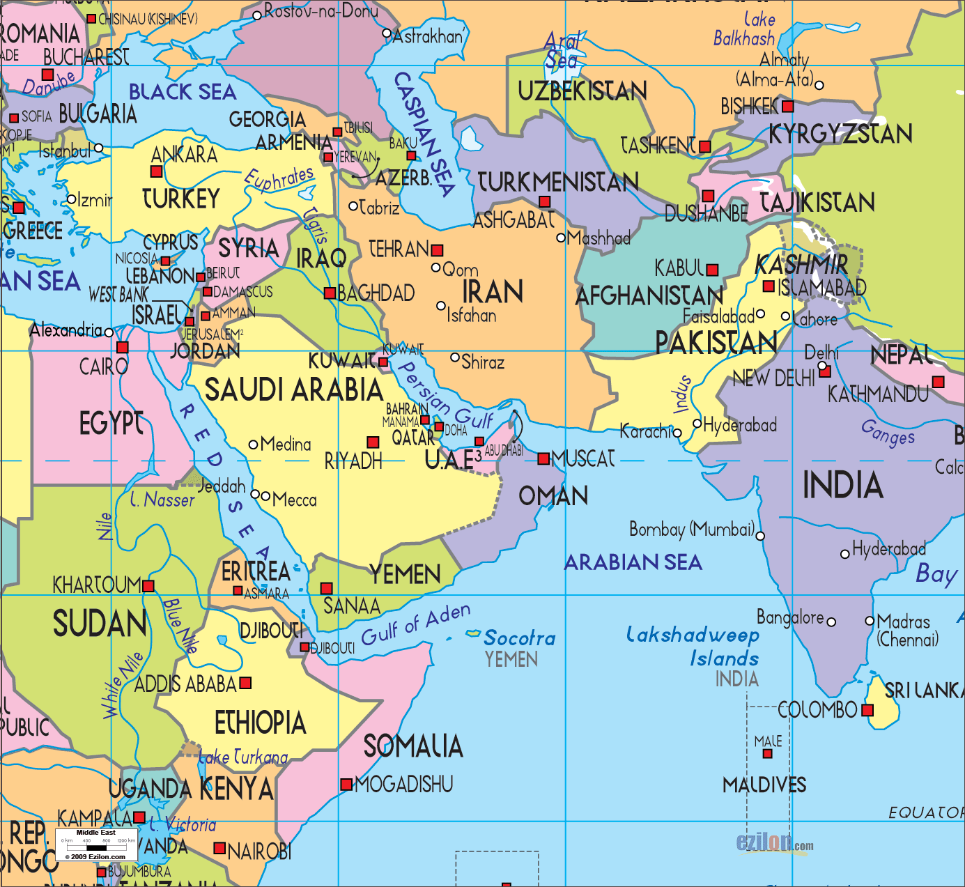
Orientation
OEF
OFS
OIF
OND
OIR
(South Sudan)
(Seychelles)
Notes:
Here’s a picture.
This is where we have been sending our troops, ranging from eastern Europe to India

Slide 8
Death During Deployment
Department of Defense (http://www.defense.gov/news/casualty.pdf)
2,359 US military deaths in OEF + OFS
20,096 wounded in action in OEF + OFS
4,493 US military deaths in OIF + OND + OIR
32,271 wounded in action in OIF + OND + OIR
Notes:
Not a very “deadly” war, relatively speaking, but look at the ratio of Wounded to Died – 8:1, 10:1. Soldiers survive. They come home. Their wounds need care.
Wars ranked by total number of U.S. military deaths[edit]
Rank, War, Years, Deaths, Deaths per Day, US Population in First Year of War, Deaths per Population (year)
1 American Civil War 1861–1865: 750,000^{[91]} 420 31,443,000 2.385% (1860)
2 World War II 1941–1945: 405,399 297 133,402,000 0.307% (1940)
3 World War I1917–1918: 116,516 279 103,268,000 0.110% (1920)
4 Vietnam War1961–1975: 58,209 11 179,323,175 (1960) 0.030% (1970)
5 Korean War1950–1953: 54,246 45 151,325,000 0.020% (1950)
6 American Revolutionary War 1775–1783: 25,000 11 2,500,000 0.899% (1780)
7 War of 18121812–1815: 15,000 15 8,000,000 0.207% (1810)
8 Mexican–American War1846–1848: 13,283 29 21,406,000 0.057% (1850)
9 War on Terror2001–present: 6,717 1.57 294,043,000 0.002% (2010)
10 Philippine–American War1899–1902: 4,196 3.8 72,129,001 0.006% (1900)

Slide 9
Death After Deployment
Deaths among VA patients following deployment 2001-2011 (Bollinger et al 2015)
Excess mortality relative to US Population, SMR 3.1:1.0
Excess mortality relative to Dept of Defense, SMR 2.1:1.0
Notes:
Now we are studying care and prevention of death including suicide.
We study death because it is so painful for the survivors, and because we abhor the imagined pain we feel on behalf of those who died.
New veterans have an elevated Mortality Ratio. We need to make this ratio smaller. We need to make this circle of death smaller.

Slide 10
Wounded Warrior Transition from DoD to VA
"Tracking OEF/OIF Transition from DOD to VA"
Established feasibility of transferring patient identifiers and health data from DoD Medical Treatment Facility to the VA on a local level
Tracked seriously wounded warriors who transitioned from Brooke Army Medical Center into the VA
Notes:
Work with the survivors of deployment for me started with a study of transition from DoD medical care to VA care.
This little study asked what % of Wounded Warriors (inpatients) transitioned into VA care after discharge from DoD hospital.

Slide 11
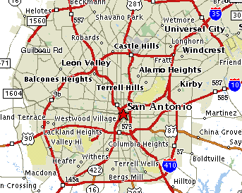
Transfer of Data from BAMC/USAISR to South Texas VA
VA:
Laurel Copeland, John Zeber, MJ Pugh, Val Lawrence
DoD:
Mona Bingham – Brooke Army Medical Center, Research Nursing Service, Fort Sam Houston
Audie Murphy VA
Fort Sam Houston
San Antonio ~465 sq mi surrounding Fort Sam
Notes:
Getting the data from DoD to VA was a matter of driving an encrypted hard drive a few miles across town (from Fort Sam Houston to the Audie Murphy VA Medical Center).
But it was a regulatory matter of great magnitude.
Regulatory barriers are still in place as DoD and VA try to protect the privacy of military personnel and veterans.
The process used in the study could not be generalized. Once the DoD collaborator was deployed and retired out of the military, the ability to transfer data ended.

Slide 12
Care Transition from DoD to VA
994 inpatients discharged FY02–FY06 from BAMC/USAISR:
62% full-time military vs. 38% Reserve/National Guard
34% with burn injuries -- TBSA averaged 16% (SD17%)
21% had mental health diagnoses, primarily --
12% drug abuse (no alcohol)
4% adjustment reaction diagnoses (no PTSD)
232 transitioned into the VA:
81% used VA mental health care
71% had psychiatric diagnoses
Half met criteria for depression (27%) or PTSD (38%)
9% had drug /alcohol abuse diagnosed (6% alc, 3% other drugs)
Receiving mental & behavioral health care was associated with staying in VA care through FY09 (98% with MBH vs 62% no MBH)
Notes:
In this study, we found that only 25% of the Wounded Warriors turned up in VA care within 3 years of discharge from DoD hospital.
Mostly they came to get mental health care. Depression and post-traumatic stress disorder are prevalent post-deployment,
And VA has the expertise to treat Veterans dealing with these problems.
(Brooke Army Medical Center and the United States Army Institute of Surgical Research – now San Antonio Military Medical Center (SAMMC))

Slide 13
Studying Veterans Outside the VA
Finley, Zeber and Noel survey of community providers
- providers not prepared to work with veterans on war-related trauma
- wide circle of influence of war-related trauma on friends and relatives of veterans
Copeland, Trent study of the Scott & White Homefront Healthcare Program which operated 2008-2012
- tremendous need for counseling among soldiers and their partners and children (anxiety, depression, family conflict)

Slide 14
Care Equity among Veterans
“Racial/ethnic disparities in monitoring metabolic parameters for patients with schizophrenia receiving antipsychotic medications”
– monitoring rates higher for whites than blacks 2002-2005, equivalent by 2009
“Prevalence of suicidality among Hispanic and African-American veterans following surgery”
–elevated for black veterans, in spite of generally lower suicide rates among blacks vs whites
Notes:
I spend a lot of time studying care equity. Here are 2 examples.

Slide 15
Care Equity among Veterans
“Use of obesity-related care by psychiatric patients”
– equivalent for SMI and non-SMI patients
“Mortality after cardiac or vascular operations by pre-existing serious mental illness status in the Veterans Health Administration”
24% with schizophrenia vs 20% non-SMI died within 1 year postop vascular surgery
“Prevalence of QT prolongation among veterans with severe mental illness”
– extremely elevated among SMI patients because of the psychotropic medications they use: heart disease risk
Notes:
I spend a lot of time studying care equity. Here are 3 examples.
As scientists, we need access to veterans or their data to figure out how to make health care better, more relevant, and timely.
I can access the medical care data on 5.5 M VA patients per year.
Heart disease is still a concern.

Slide 16
Well-Being of Newly Post-Deployment Veterans
The Veterans Metrics Initiative: Linking Program Components to Post-Military Well-Being
- in start-up
- will survey 7,500 veterans who separated from the military 2-3 months before
- goal: identify what components we should put into our transition assistance programs to help new veterans the most
- focus on the whole veteran: mental health, physical health, employment & job satisfaction, social & community reintegration, romantic attachment and family
Notes:
Now I am involved in a new survey study.

Slide 17
Contact Information
Laurel A Copeland, MPH PhD
Center for Applied Health Research, Central Texas Veterans Health Care System, jointly with Baylor Scott & White Health
2102 Birdcreek Drive
Temple, Texas 76502
Tel: 254-215-9880
E: Laurel.Copeland@VA.gov or Laurel.Copeland@BSWHealth.org
T: @laurel99994321

